Slide 1
Spatial Proteomics
Prof. Jean Fan

Slide 2
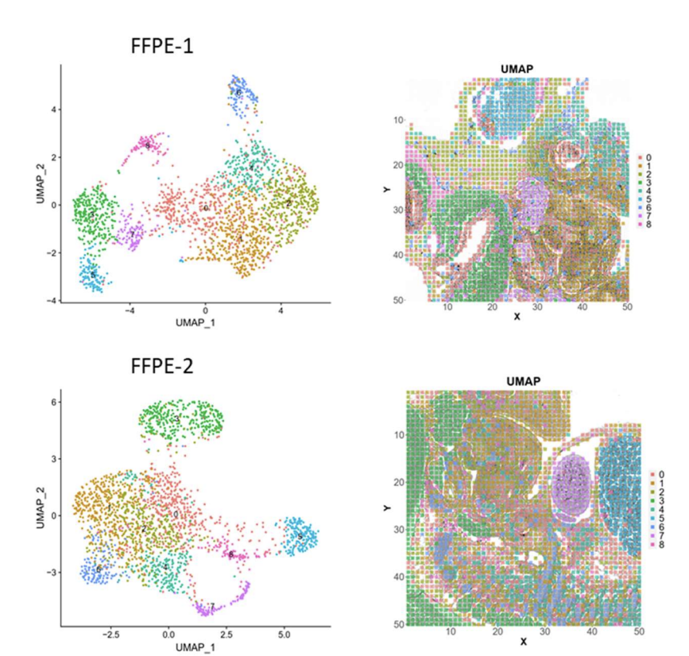
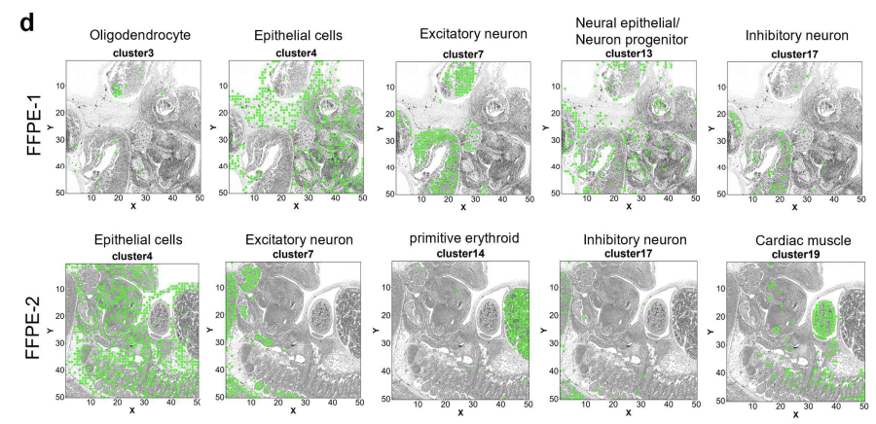
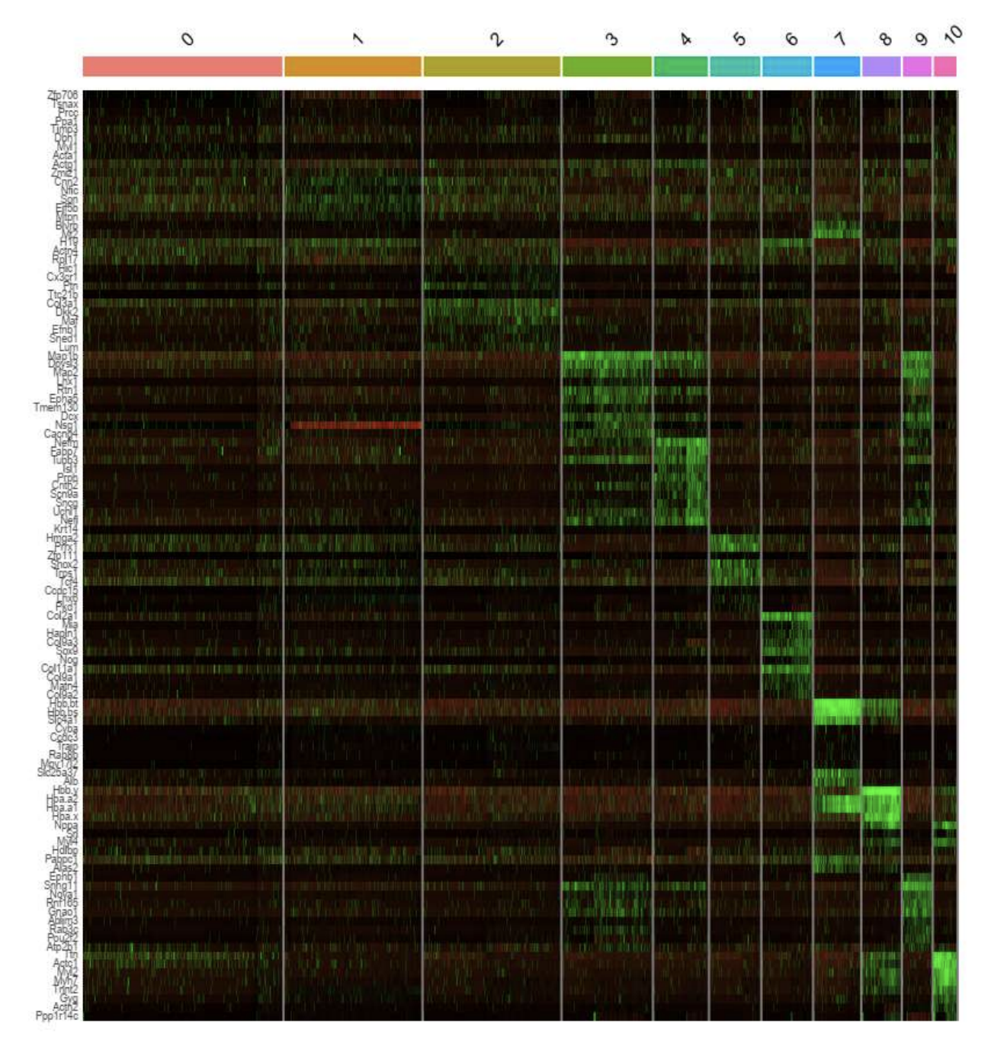
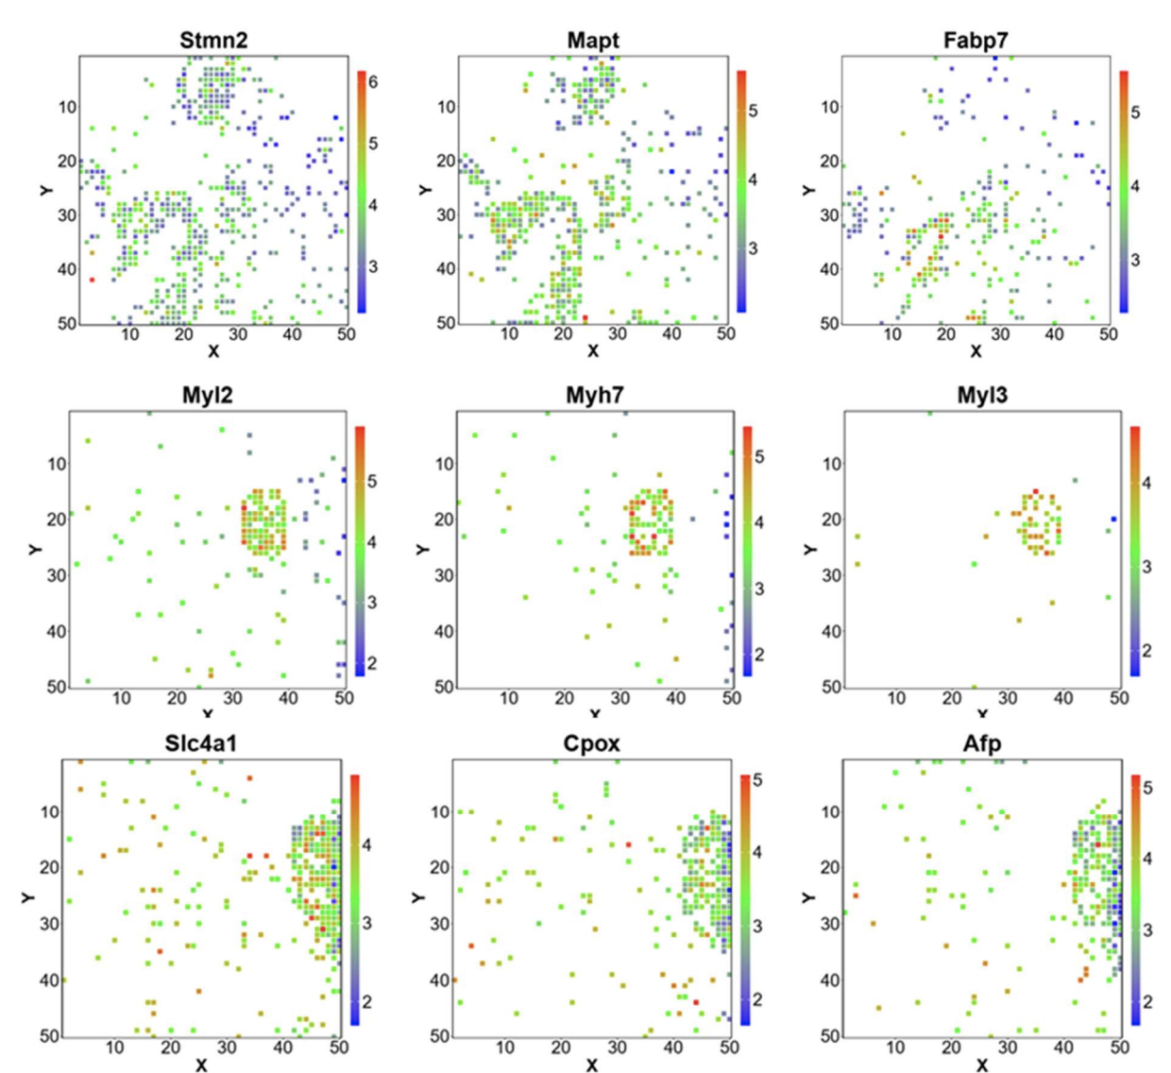
Homework tips: Your goal is to convince me that your cell-type interpretation is correct (actually being correct is not important here; your process and use of data visualization is key)
https://www.biorxiv.org/content/10.1101/2020.10.13.338475v2.full.pdf

Slide 3
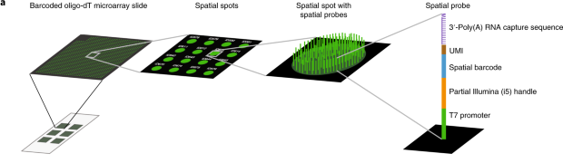
Review of spatially resolved transcriptomics by spot-based-capture and next-gen sequencing
Each of the Capture Areas has 5,000 uniquely spatially barcoded spots
Each spot contains on the order of millions of oligos

Slide 4
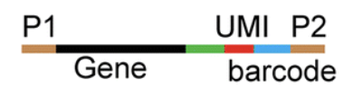
Review of spatially resolved transcriptomics by spot-based-capture and next-gen sequencing
ATCGGATCGTATAAATGCGTAGCTAGTC----AATG----AGTT
ATCGGATCGTATAAATGCGTAGCTAGTC----TTTG----AGTT
ATCGGATCGTATAAATGCGTAGCTAGTC----TTTG----AGTT
TTGAGTATATGATGAAGATGAAAGGAT----AGGT----AGTT
TTGAGTATATGATGAAGATGAAAGGAT----ATTG----GTAA
TTGAGTATATGATGAAGATGAAAGGAT----GATA----GTAA
…
…

Slide 5
Why protein?

Slide 6
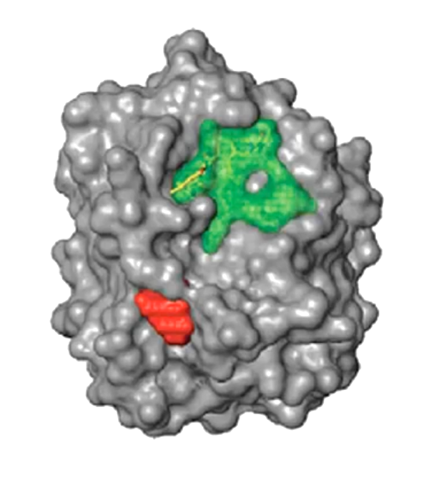
How can we detect proteins?
Protein
Epitope
(antigenic determinant)

Slide 7
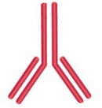
Protein epitopes can be identified with antibodies
(primary) Antibody

Slide 8
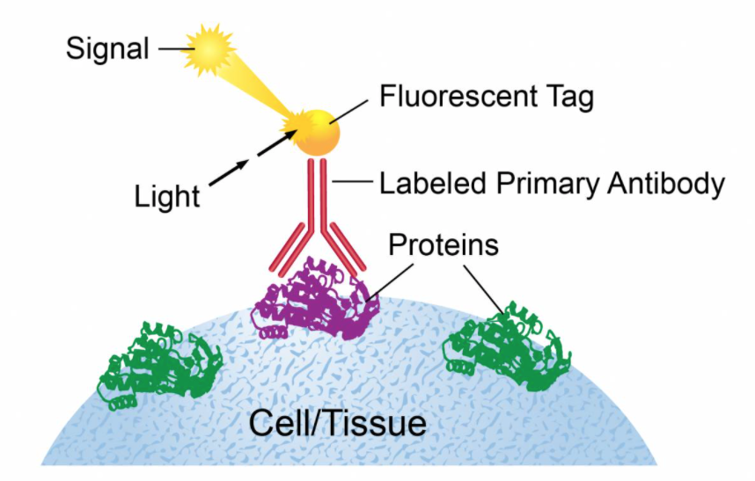
Ex. Immunofluorescence

Slide 9
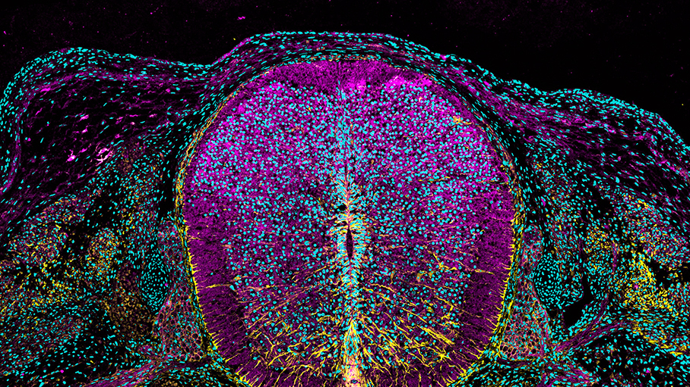
https://www.cell.com/pictureshow/immunofluorescence-ii
Vimentin (yellow)
N-cadherin (magenta)
Dapi (cyan)

Slide 10
What are antibodies? How are they made?

Slide 11
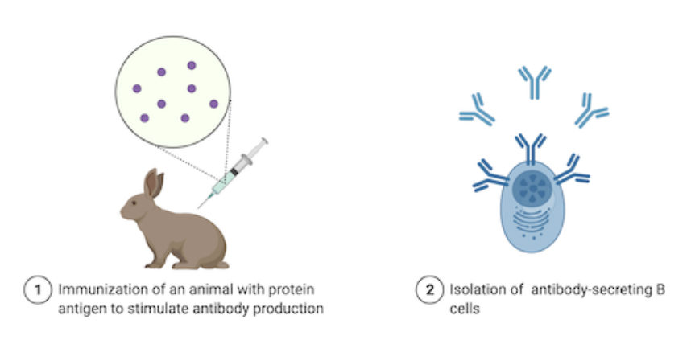
What are antibodies? How are they made?
Can stop here
but b-cells
are polyclonal
+ don’t live long
Source: https://blog.addgene.org/antibodies-101-monoclonal-antibodies

Slide 12
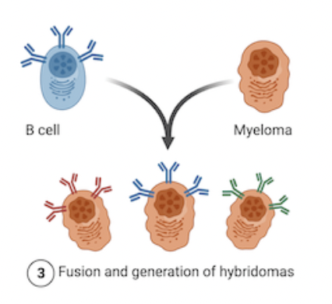
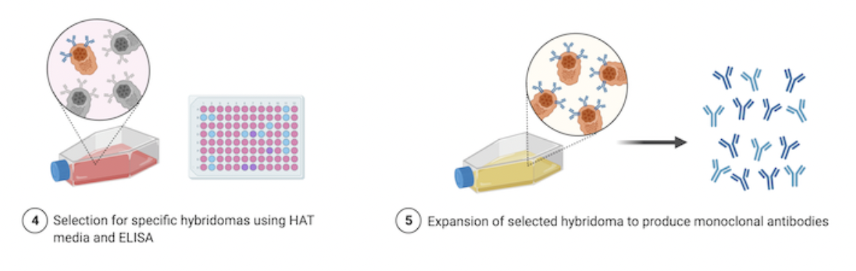
What are antibodies? How are they made?
1970s (Nobel Prize of 1984)
Source: https://blog.addgene.org/antibodies-101-monoclonal-antibodies

Slide 13
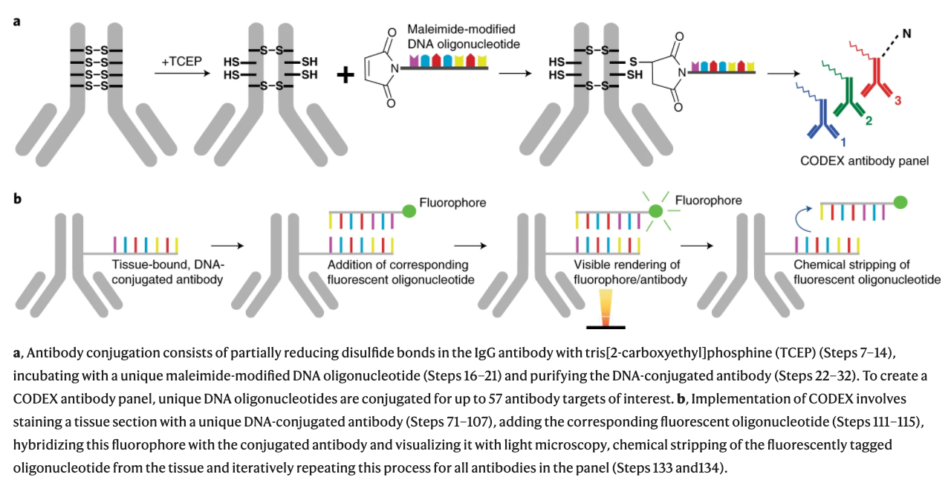
CODEX (CO-Detection by indEXing)
Dr. Gary Nolan at Stanford
Black, et al. Nat Protoc 2021

Slide 14
CODEX (CO-Detection by indEXing)
Dr. Gary Nolan at Stanford
Black, et al. Nat Protoc 2021

Slide 15
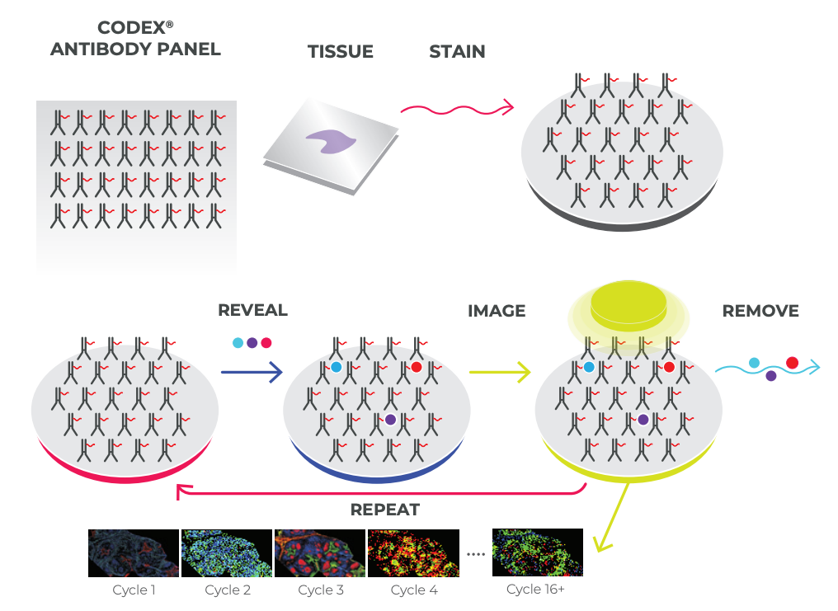
CODEX (CO-Detection by indEXing)
Akoya. Technical Note. Validation of CODEX Antibodies

Slide 16
CODEX (CO-Detection by indEXing)
~40 proteins
Akoya. Technical Note. Validation of CODEX Antibodies

Slide 17
Quick Question
We want to measure 18 proteins in a tissue
Using CODEX with 3 colors, we can measure 3 proteins in each imaging round
How many rounds of imaging do we need to image all 18 proteins?

Slide 18
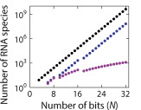
Quick Question
Recall: MERFISH used a multiplexing scheme to increase the number of different genes that can be measured
Why do we not using multiplexing for proteins?
Black is 2^N
Purple is with modified hamming distance
Source: https://www.sciencedirect.com/science/article/abs/pii/S0076687916001324

Slide 19
What are some potential challenges for characterizing the proteome?
Proteins are big -> “crowding” (steric hindrance)
> 20k needed to measure the whole proteome
Very hard to get good antibodies
Good specificity

Slide 20
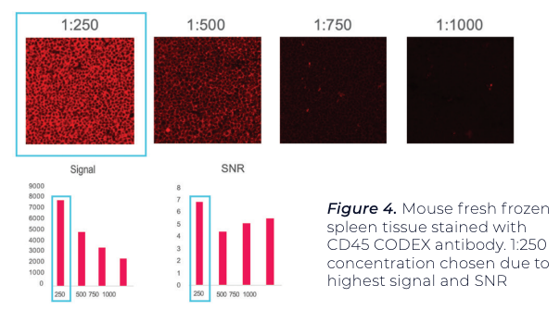
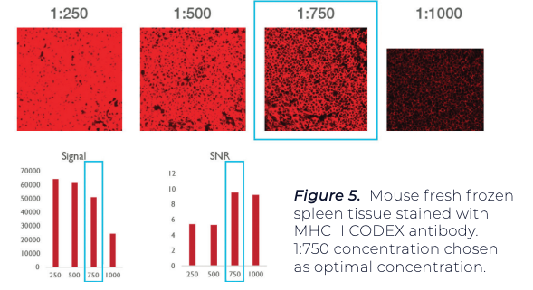
Antibody titration needed to minimize non-specific binding and improve signal to noise ratio
Using positive test tissue, maximize signal-to-noise ratio (SNR) and average signal.
A threshold is set for both signal and noise.
A binary map is used to confirm that pixels associated with signal and noise
Antibody A
Antibody B

Slide 21
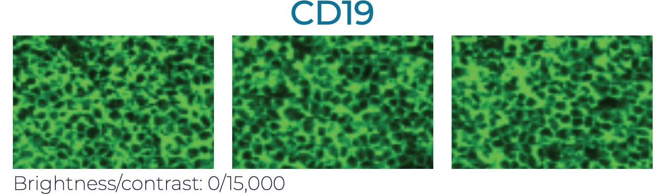
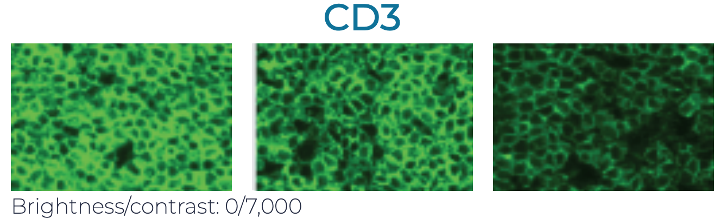
Antibodies may interfere with each other (steric hindrance)
Even if it works well by itself, it may not give the same performance when used in combination with others. Therefore need to test:
Individually
In the presence of a few other antibodies (positive and negative counterstains)
In the presence of many other antibodies
1
2
3

Slide 22
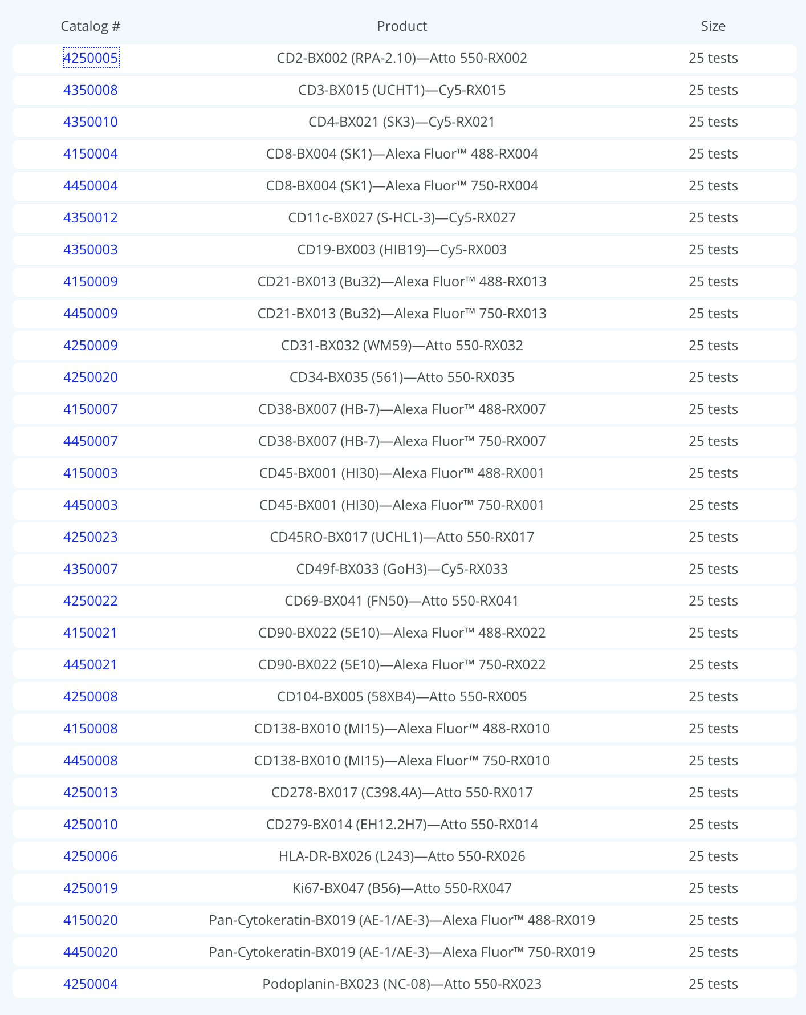
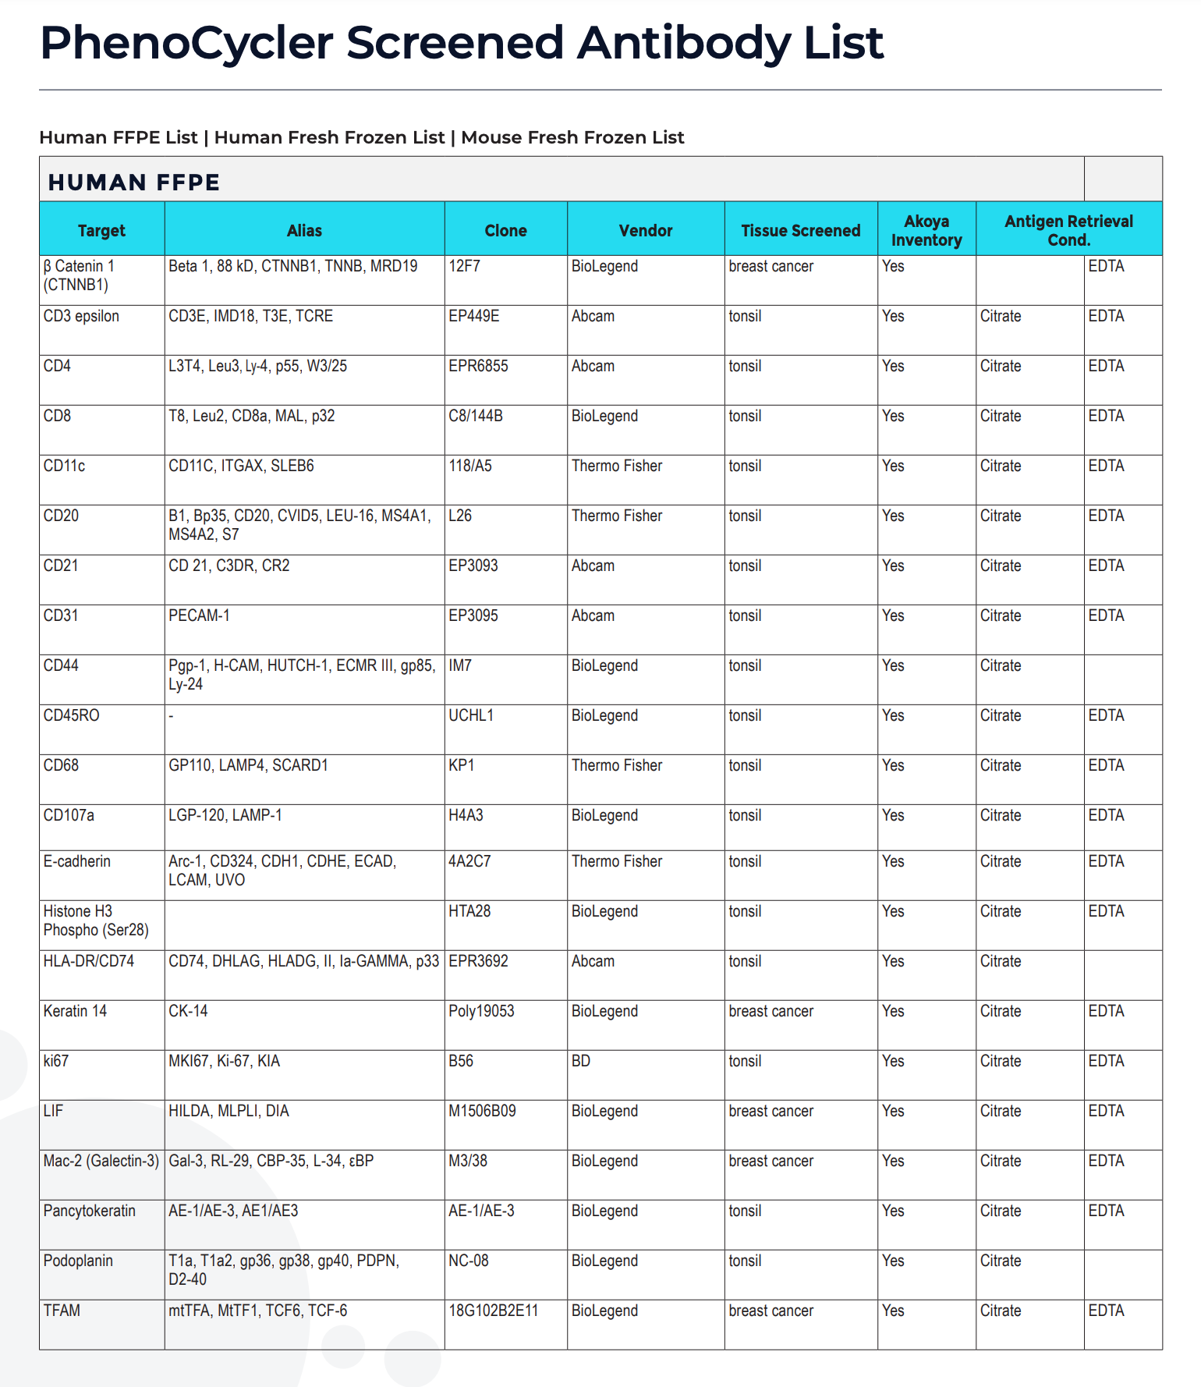
Antibodies for proteins of interest may not be available
~ 30 approved (work well together)
~ 300 screened (unclear if will work well together)
How many different proteins are in the proteome?
(on the order of)
Recall we have ~20k different RNAs
Notes:
80,000 to 400,000 proteins

Slide 23
Today’s hands on component: Look at spatial proteomics data: bit.ly/GDV_codex Extra Credit HW Assignment (like HW5 and HW6 but for this CODEX data)
Due 3/10 (Midnight) ie. before Final Class Presentations

